Slide 1
Training Model 만들기
21.08.19
길다영
https://github.com/sunset1995/HorizonNet 참고.

Slide 2
Index
1.
Enter the title
Enter the title
Enter the title
Estimating layout with HorizonNet
실행 결과 비교
Sub Title
Sub Title
Sub Title
Sub Title
Sub Title
Sub Title
Sub Title
Sub Title
Sub Title

Slide 3
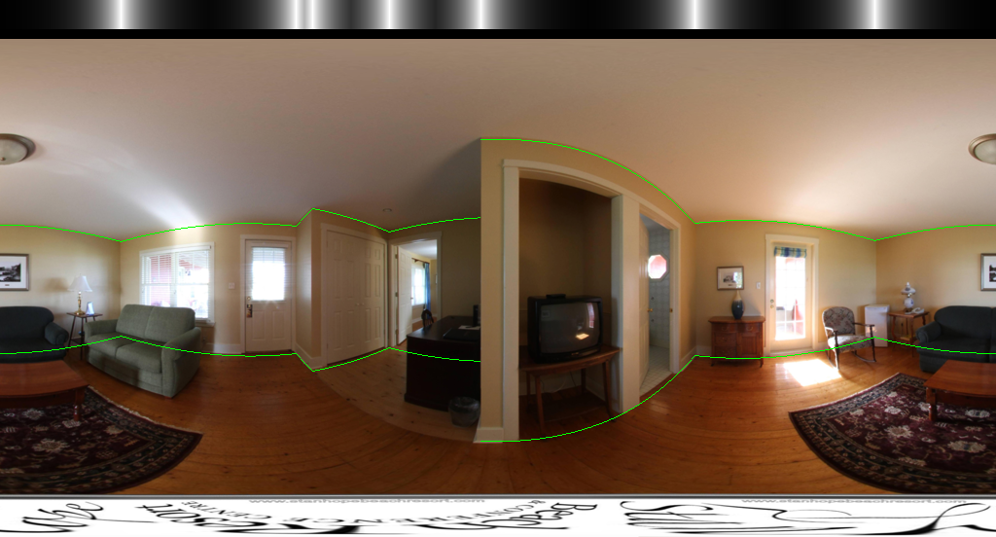
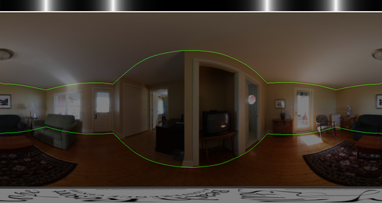
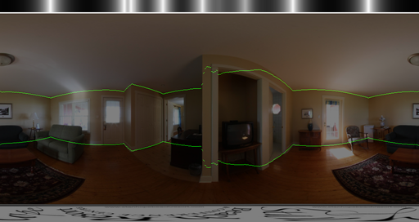
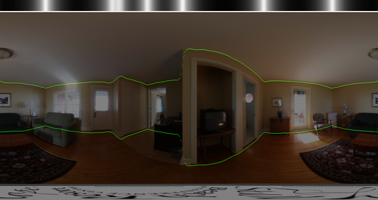
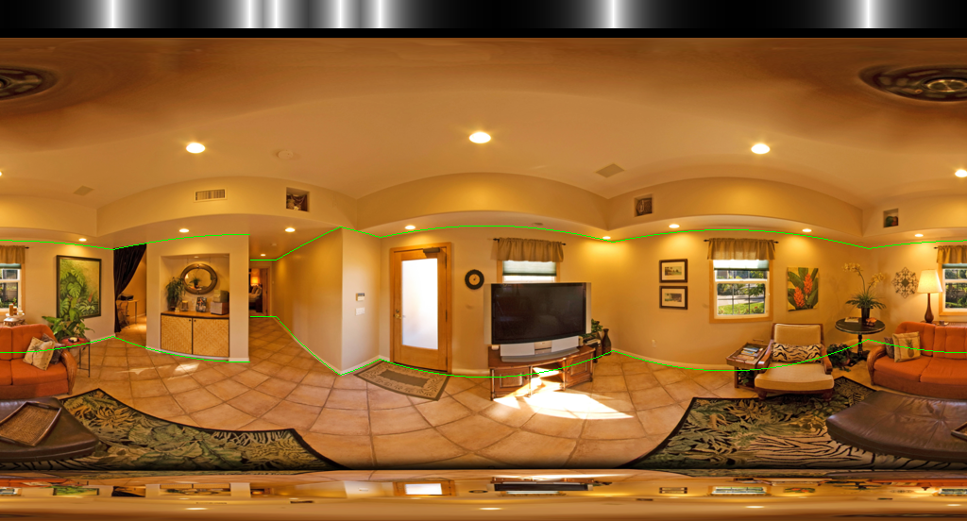
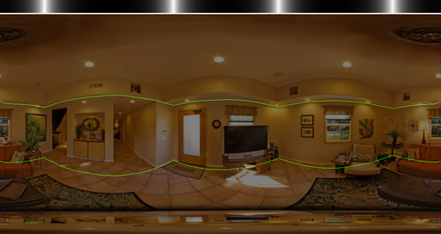
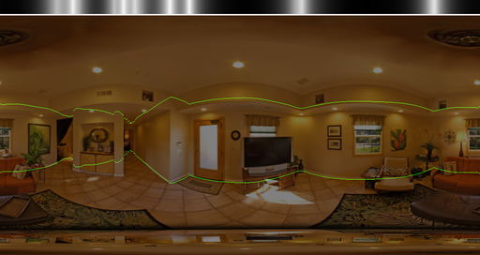
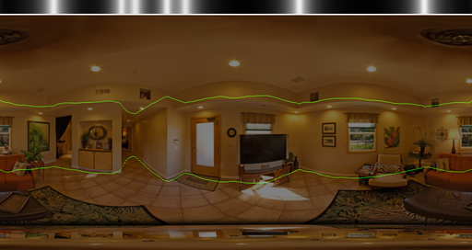
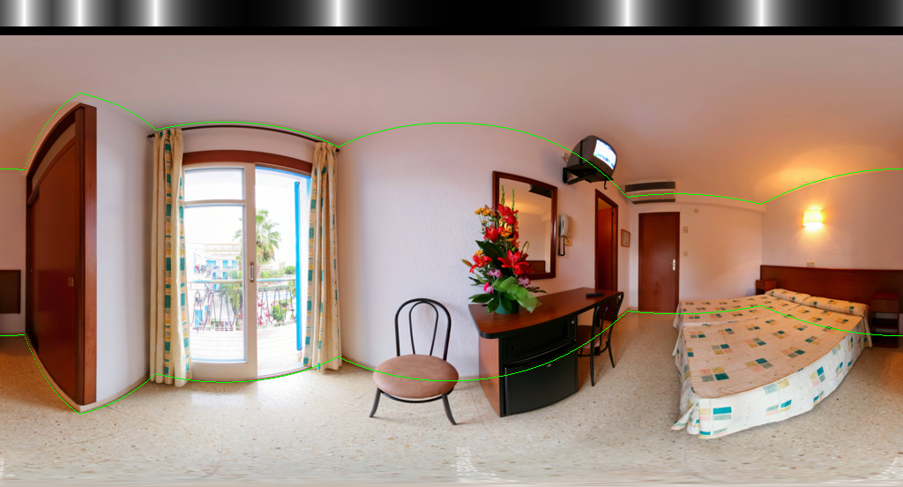
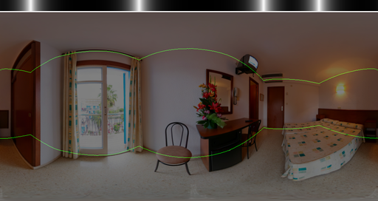
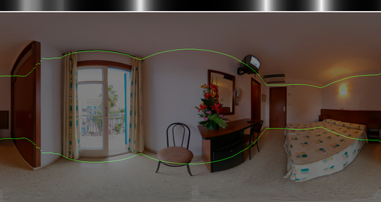
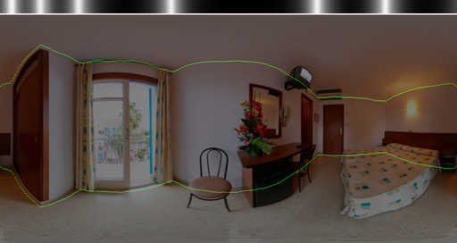
1. Estimating layout with HorizonNet 실행 결과 비교
Finetune_general/visual | Panos2d3d.pth | St3d.pthf | resnet50

Slide 4
1. Estimating layout with HorizonNet 실행 결과 비교
딱 보기에도 finetune의 밝기가 다른 것들에 비해 더 밝고 resnet50과 가장 유사함.
Training img를 밝기 조정 후 resnet50으로 다시 훈련 시켜 보려 함.
만약 결과가 달라지지 않는다면 valid img도 밝기 조정해볼 계획임.

Slide 5
Thank You.

Slide 6
POWERPOINT TEMPLATE
Enter the title
ENTER THE CONTENTS
I believe that someone like you. I was broken my heart. But now, I am standing again.
1
2
3
Something
Something
Something
I believe that someone like you. Enter something here.
I believe that someone like you. Enter something here.
I believe that someone like you. Enter something here.

Slide 7
POWERPOINT TEMPLATE
Enter the title
ENTER THE CONTENTS
I believe that someone like you
ENTER
Someone
SomeThing
Something
I believe that someone like you
80%
90%

Slide 8
POWERPOINT TEMPLATE
Enter the title
23%
ENTER CONTENTS
40%
ENTER CONTENTS
68%
ENTER CONTENTS
I want you to use this template for free and to remember slug and CREBUGS for me.

Slide 9
POWERPOINT TEMPLATE
Enter the title
ENTER THE CONTENTS
I believe that someone like you. I was broken my heart. But now, I am standing again.
A
Someone
I believe that someone like you. Enter something here.
Someone
B
C
I believe that someone like you. Enter something here.
Someone
I believe that someone like you. Enter something here.

